Slide 1
Lab1
Platform Introduction & MPI
Parallel Programming 2024
2024/09/12

Slide 2
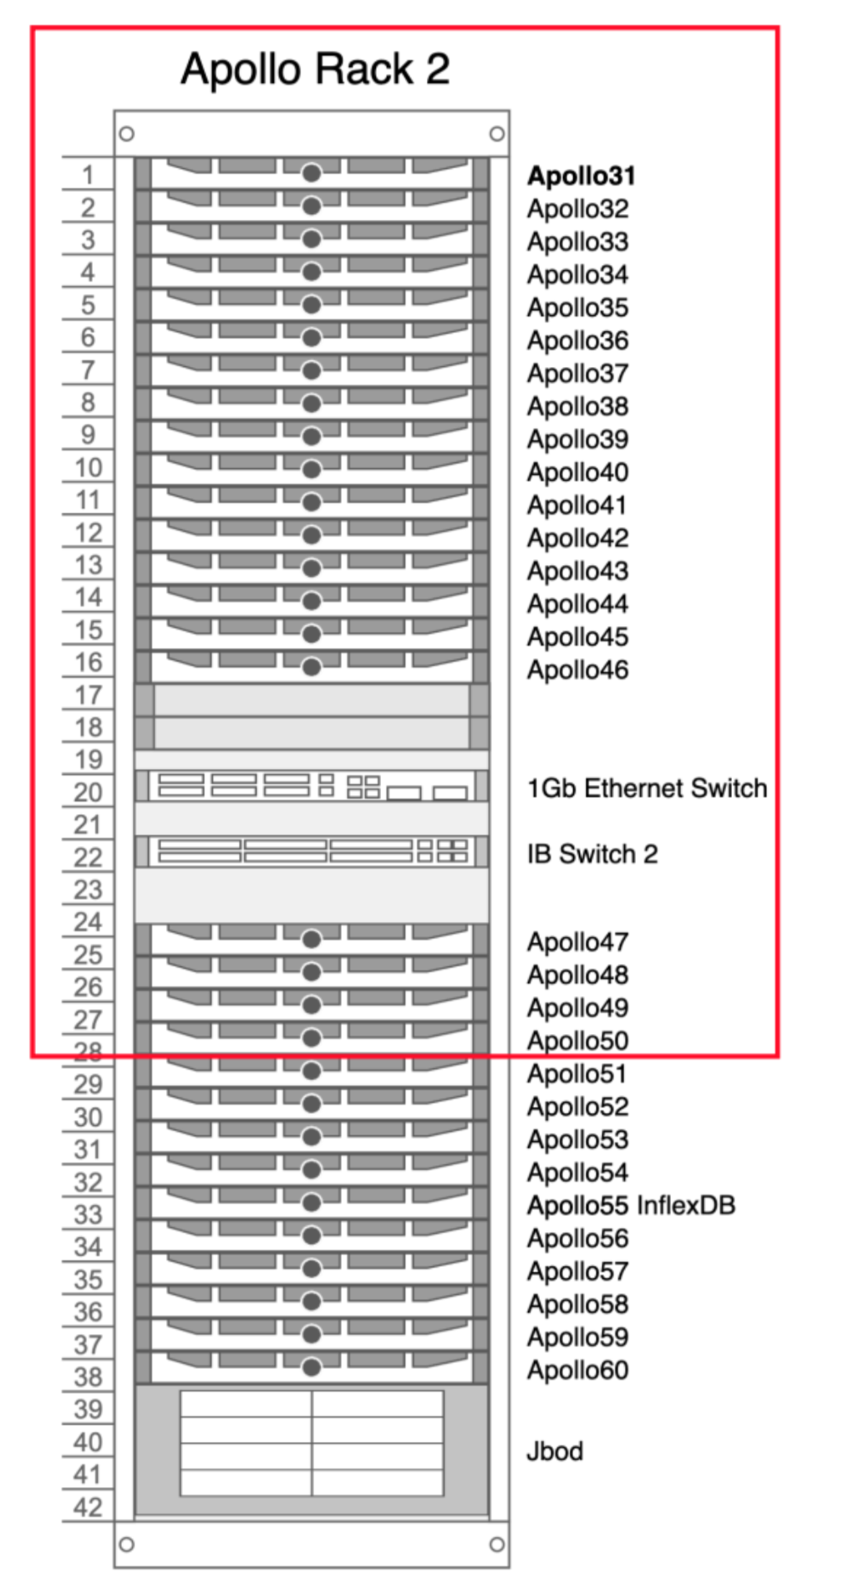

Platform Introduction - Apollo
20 nodes for this course (apollo[31-50])
1 head node: apollo31
19 compute nodes: apollo[32-50]
Intel X5670 2x6 cores @ 2.93GHz
HyperThreading is enabled only on the head node
96GB RAM on each node
QDR Infiniband (40 Gb/s)
OS: Arch Linux (kernel 5.15.90)
Storage
/home & /opt : 4x RAID10 HDD
For storing files & codes
/share : BeeGFS parallel file system
For performance benchmarking

Slide 3
Available resources
1 login node (apollo31) (200%CPU max)
19 compute nodes (1200% CPU max)
Use squeue to view Slurm queues
Cluster monitor: http://apollo.cs.nthu.edu.tw/monitor
Monitor CPU & memory usage of each node
48GB disk space per user
Use quota -s to view your disk quota

Slide 4
Login to the Apollo Cluster

Slide 5
Login to Apollo
Address: apollo.cs.nthu.edu.tw
Username: check email
Password: check email
MINING IS PROHIBITED. Also, do not attack the server.

Slide 6
SSH - Linux and Mac
Open terminal
ssh pp24sXX@apollo.cs.nthu.edu.tw
Enter password
You'll be asked to change your password on the first login

Slide 7
SSH - Windows
Tools
MobaXterm
Putty
Cmd or Powershell (Windows 10)
Windows Terminal (Windows 11)
ssh pp24sXX@apollo.cs.nthu.edu.tw
Enter password
You'll be asked to change your password on the first login

Slide 8
Some useful command
Login: ssh pp24sXX@apollo.cs.nthu.edu.tw
File transfer:
rsync -avhP filename pp24sXX@apollo.cs.nthu.edu.tw:filename
Editors: vim emacs nano
Slurm job queue: squeue
Disk quota: quota -s
Change password: passwd
Download file: wget aria2c
Code syntax highlighting: pygmentize

Slide 9
Using the Apollo Cluster

Slide 10
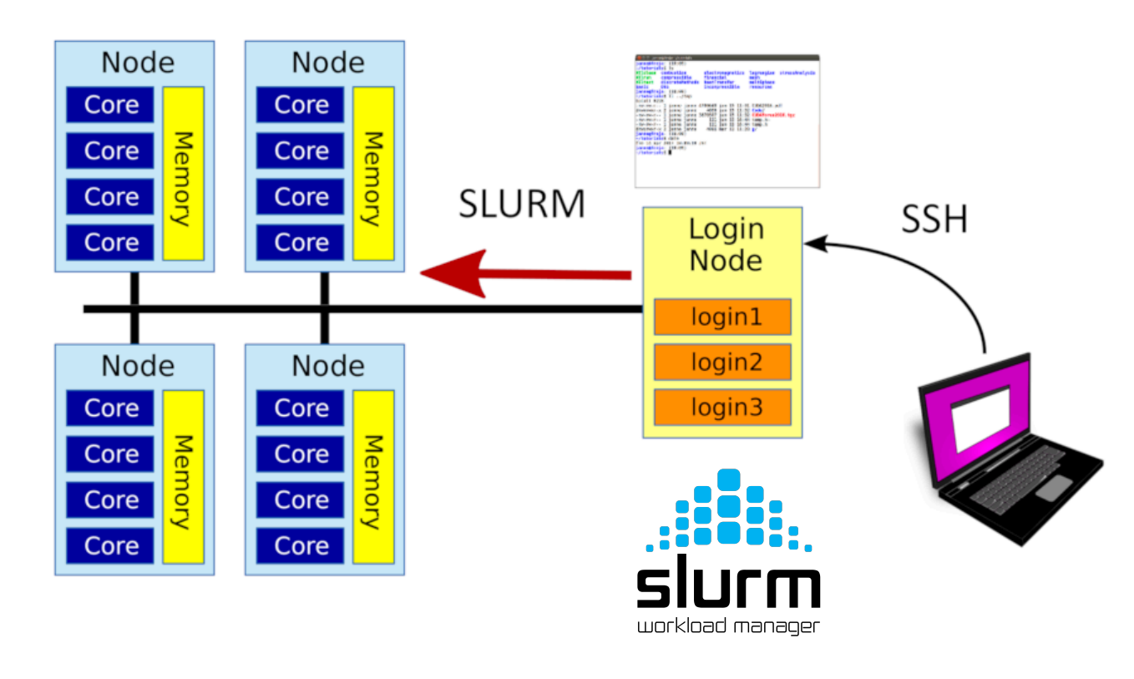
Slurm Workload Manager
On a cluster system, there are multiple users and multiple nodes. Slurm schedules jobs submitted by users across different nodes, so that the same resource is not used by two jobs at the same time (to ensure accuracy of performance-critical experiments), and also increases the utilization of the cluster.
Note: Slurm prefers the following jobs:
short jobs (you can set time limit)
less resource demanding jobs
jobs queued for a long time
users that haven't run a lot of jobs recently
Notes:
Slurm(Simple Linux Utility for Resource Management)
用戶在集群中提交作業時，SLURM 會將作業放入等待隊列中，並根據作業的需求和集群的可用資源，將作業分配到一個或多個節點上。當資源空閒時，SLURM 調度器會從隊列中選擇下一個要運行的作業，並將其調度到合適的節點上。
用戶可以使用 sbatch 提交批處理作業，使用 srun 直接運行作業，使用 squeue 查看當前的作業隊列，使用 scancel 取消作業，以及使用 scontrol 管理和配置作業及集群。

Slide 11
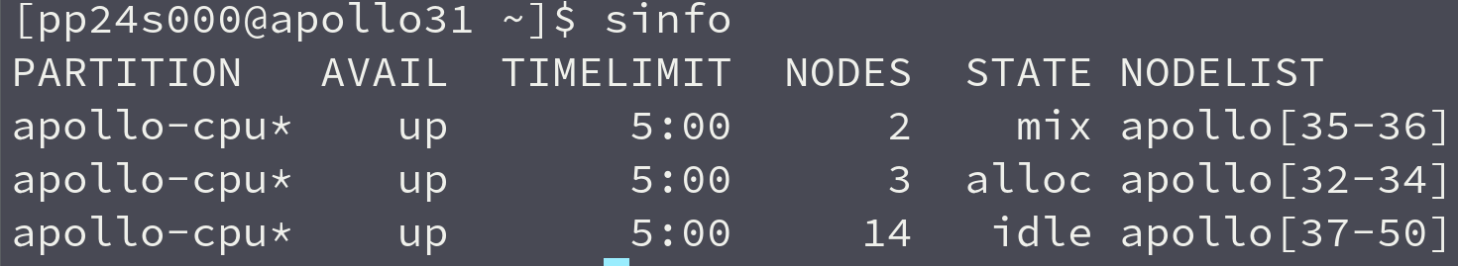
Slurm Workload Manager
Show partition information
sinfo
Displays the information about Slurm nodes and partitions, providing an overview of the cluster's status.
We have only one partition, which is the CPU partition
idle: The nodes are not allocated
alloc: The nodes are fully allocated
mix: The nodes are partially allocated
down / drain: The nodes are out of service (we will fix them ASAP!)

Slide 12
Slurm Workload Manager
Interactive Job submission
srun [options] ./executable [args]
Options:
-N NODES: The the minimum number of nodes to run the job
-n PROCESSES: The number of total process to launch
-c CPUS: The number of cpus available to each process (i.e. threads per process)
-t TIME: The time limit in "minutes" or "minutes:seconds"
-J NAME: The name of the job. Will be displayed on squeue.
srun -N 2 -n 8 -c 2 ./hello_world
Runs a total of 8 processes, each using 2 CPUs, on at least 2 nodes
6 processes * 2 cpus on 1st node (CPU Allocation: 12/12)
2 processes * 2 cpus on 2nd node (CPU Allocation: 4/12)

Slide 13
Slurm Workload Manager
Batch Job submission
sbatch script.sh
script.sh
#!/bin/bash
#SBATCH -J BatchRun
#SBATCH -N 2
#SBATCH -n 4
#SBATCH -c 6
srun ./hello_world

Slide 14
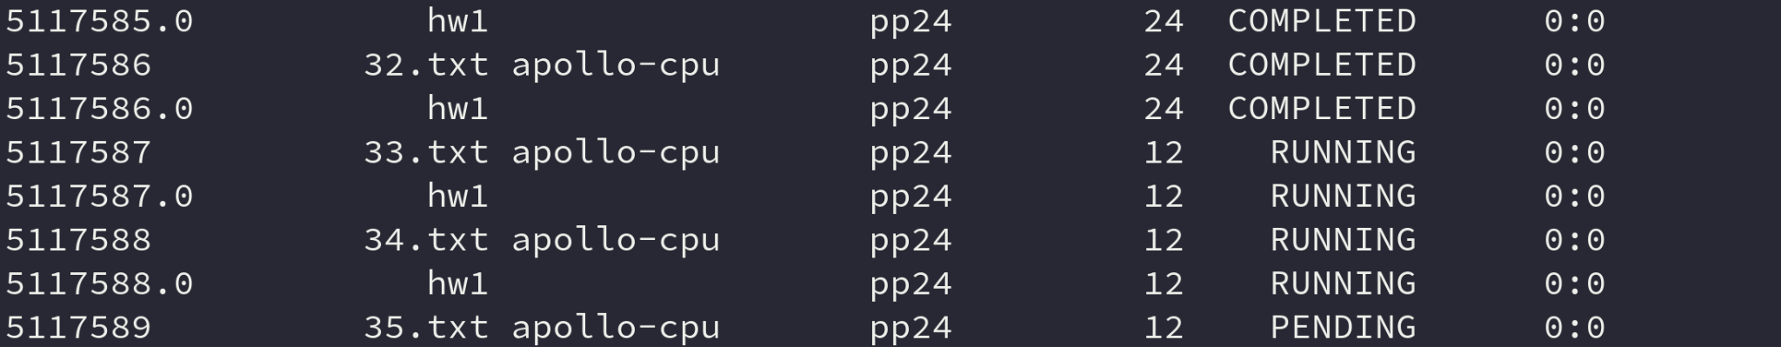
Slurm Workload Manager
Tracking your jobs
sacct

Slide 15
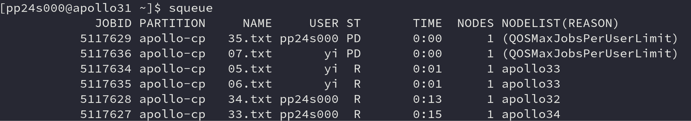
Slurm Workload Manager
Show the job queue
squeue

Slide 16
Slurm Workload Manager
Cancel a job
scancel [Job ID]

Slide 17
Environment Modules (module)
A tool to simplify shell initialization and dynamically manage environment settings using “modulefiles”.
Dynamically update environment variables like PATH, LD_LIBRARY_PATH.
Simplify the process of switching between different software versions.
Ideal for managing complex software dependencies.
Used on almost ALL supercomputing clusters

Slide 18
Common usages
Show Module Info
module show <module_name>
E.g., module show openmpi
Swap Modules
module swap <module1> <module2>
E.g., module swap mpi/latest openmpi
Unload All Modules
module purge
List Available Modules
module avail
Load a Module
module load <module_name>
E.g., module load mpi/latest
Unload a Module
module unload <module_name>
E.g., module unload mpi/latest
List Loaded Modules
module list

Slide 19
MPI Hello World

Slide 20
MPI Hello World (Send, Recv Test)
#include "mpi.h"
#include <stdio.h>
#include <string.h>
int main(int argc, char *argv[])
{
int i, rank, size, namelen;
char name[MPI_MAX_PROCESSOR_NAME];
MPI_Status stat;
MPI_Init(&argc, &argv);
MPI_Comm_size(MPI_COMM_WORLD, &size);
MPI_Comm_rank(MPI_COMM_WORLD, &rank);
MPI_Get_processor_name(name, &namelen);
if (rank == 0) {
printf("Hello world: rank %d of %d running on %s\n", rank, size, name);
for (i = 1; i < size; i++) {
MPI_Recv(&rank, 1, MPI_INT, i, 1, MPI_COMM_WORLD, &stat);
MPI_Recv(&size, 1, MPI_INT, i, 1, MPI_COMM_WORLD, &stat);
MPI_Recv(&namelen, 1, MPI_INT, i, 1, MPI_COMM_WORLD, &stat);
MPI_Recv(name, namelen + 1, MPI_CHAR, i, 1, MPI_COMM_WORLD, &stat);
printf("Hello world: rank %d of %d running on %s\n", rank, size, name);
}
} else {
MPI_Send(&rank, 1, MPI_INT, 0, 1, MPI_COMM_WORLD);
MPI_Send(&size, 1, MPI_INT, 0, 1, MPI_COMM_WORLD);
MPI_Send(&namelen, 1, MPI_INT, 0, 1, MPI_COMM_WORLD);
MPI_Send(name, namelen + 1, MPI_CHAR, 0, 1, MPI_COMM_WORLD);
}
MPI_Finalize();
return (0);
}
Get this code on Apollo:
cp /opt/intel/mpi/test/test.c .
Notes:
Note: Why does MPI_Init take argc and argc as argument?
https://stackoverflow.com/questions/2642996/why-does-mpi-init-accept-pointers-to-argc-and-argv

Slide 21
MPI_Send
int MPI_Send(const void *buf,
int count,
MPI_Datatype datatype,
int dest,
int tag,
MPI_Comm comm)

Slide 22
MPI_Recv
int MPI_Recv(void *buf,
int count,
MPI_Datatype datatype,
int source,
int tag,
MPI_Comm comm,
MPI_Status *status)

Slide 23
Provided Compilers & MPIs
Compilers
GCC 12.2.1 (Default)
gcc / g++
Intel Compiler Classic
module load compiler
icc / icpc
Intel oneAPI Compiler
module load compiler
icx / icpx
MPI Implementations
Intel MPI
module load mpi
OpenMPI 4.1.6 + UCX
module load openmpi

Slide 24
Using different combinations of MPI & compilers
Intel MPI + GCC
module load mpi
mpicxx …
Intel MPI + ICC
module load mpi compiler
I_MPI_CXX=icpc mpicxx …
OpenMPI + GCC
module load openmpi
mpicxx …
OpenMPI + ICC
module load openmpi compiler
OMPI_CXX=icc mpicxx …
Notes:
MPI（Message Passing Interface，消息傳遞接口）是一個標準化的應用程式介面（API），用於在分佈式計算環境中進行進程間通信。MPI 通常用於高性能計算（HPC），它允許不同的計算節點（或處理器）之間高效地傳遞數據，這樣可以實現大型並行應用程序的協同計算。
mpicxx：這是一個 MPI 編譯器命令，它實際上是調用了底層的 C++ 編譯器（例如 g++），並且連接了 MPI 庫。你可以使用它來編譯 MPI 程序，這樣生成的二進制文件可以在 MPI 支持的環境下運行。

Slide 25
Practice
Compile and run the hello world program.
mpicxx test.c -o test
./test
Compare different srun options

Slide 26
Measuring time in your code

Slide 27
Correct measurement method
srun -n4 time ./hello
sbatch & time srun
MPI_Wtime()
omp_get_wtime()
clock_gettime(CLOCK_MONOTONIC, ...)
std::chrono::steady_clock
#!/bin/bash
#SBATCH -n 4
#SBATCH -N 2
time srun ./hello

Slide 28
Example: MPI_Wtime()
double starttime, endtime;
starttime = MPI_Wtime();
.... stuff to be timed ...
endtime = MPI_Wtime();
printf("That took %f seconds\n",endtime-starttime);

Slide 29
Example: clock_gettime(CLOCK_MONOTONIC, ...)
int main() {
struct timespec start, end, temp;
double time_used;
clock_gettime(CLOCK_MONOTONIC, &start);
.... stuff to be timed ...
clock_gettime(CLOCK_MONOTONIC, &end);
if ((end.tv_nsec - start.tv_nsec) < 0) {
temp.tv_sec = end.tv_sec-start.tv_sec-1;
temp.tv_nsec = 1000000000 + end.tv_nsec - start.tv_nsec;
} else {
temp.tv_sec = end.tv_sec - start.tv_sec;
temp.tv_nsec = end.tv_nsec - start.tv_nsec;
}
time_used = temp.tv_sec + (double) temp.tv_nsec / 1000000000.0;
printf("%f second\n", time_used);
}

Slide 30
Wrong measurement method
time srun -n4 ./hello: this time include queuing time
time(NULL): the resolution is too low (1-second)
clock(): it will count 2x time when using two threads and will not include I/O time.
clock_gettime(CLOCK_REALTIME, ...): it will be affected by NTP adjustments and DST changes.
std::high_resolution_clock::now(): it may be affected by NTP adjustments and DST changes.

Slide 31
Lab 1 - Pixels in circle

Slide 32

Pixels in circle
Suppose we want to draw a filled circle of radius r on a 2D monitor, how many pixels will be filled?
We fill a pixel when any part of the circle overlaps with the pixel. We also assume that the circle center is at the boundary of 4 pixels.
For example, 88 pixels are filled when r=5.

Slide 33
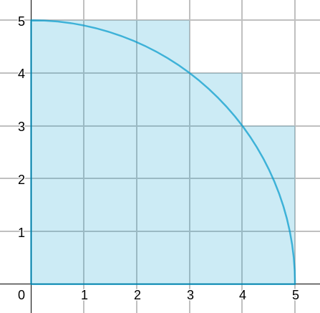
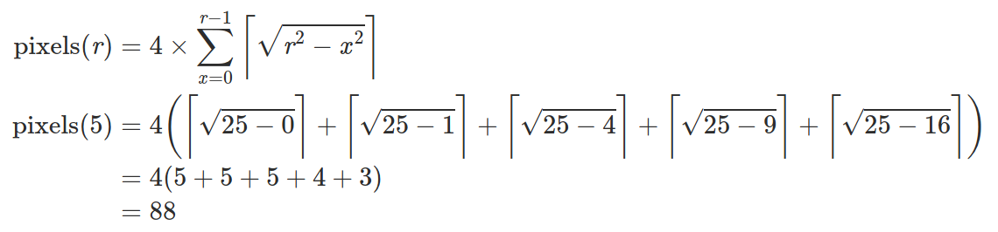
Pixels in circle
Equation:
Example: r = 5

Slide 34
Lab Spec
Parallelize the calculation using MPI.
Program input format: srun -Nnode -nproc ./lab1 r k
node: number of nodes
proc: number of MPI processes
r: the radius of circle, integer
k: integer
Program output: pixels % k (Since the output pixels may be very large, we output the remainder instead.)
Your program should be at least (n/2) times faster than the sequential version when running with n processes. For example, when running with 12 processes, your execution time should not exceed 1/6 of the sequential code.

Slide 35
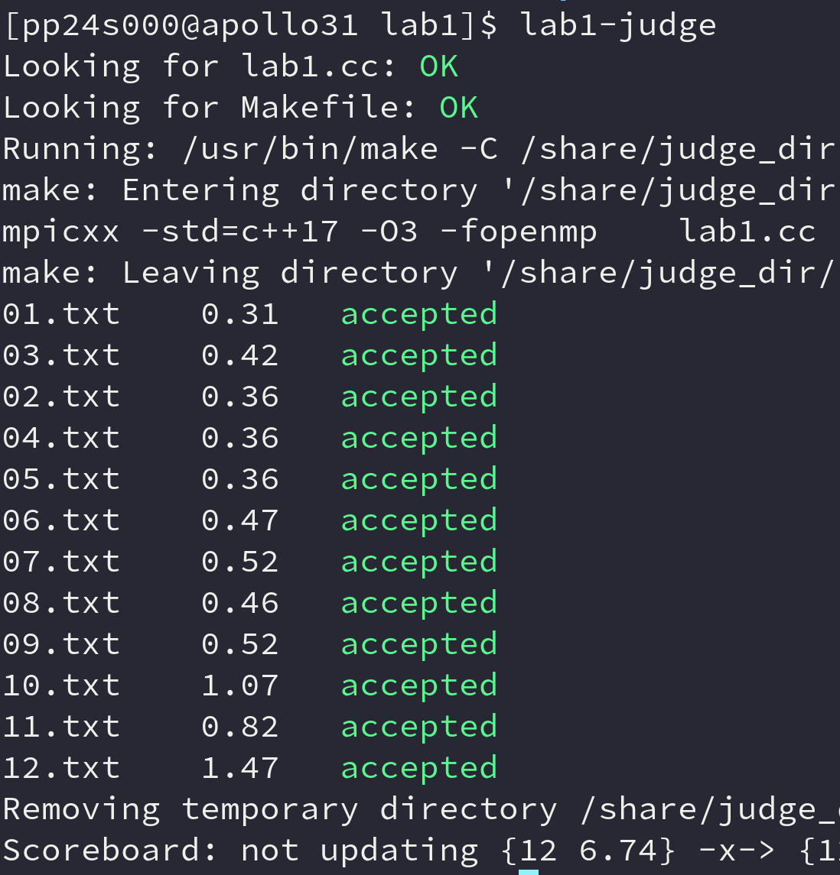
Lab Spec
The sequential code lab1.cc and a build file Makefile can be found at /home/pp24/share/lab1/sample, copy these files to your home directory.
All of the test cases can be found in /home/pp24/share/lab1/testcases
Within the same directory of lab1.cc and Makefile, run lab1-judge to check.
Scoreboard
Submit your code to eeclass:
lab1.cc
Makefile (optional, if you change any compile flags)
module.list (optional)
By default, will use GCC & Intel MPI to judge your code
If you are using other modules (such as openmpi), run module save ./module.list to generate it
Due: 9/19 (Thu.) 23:59 (1 week)
Full score for AC of all 12 test cases; otherwise, zero.

Slide 36

HW1: Odd-Even Sort
Spec
Due: 11/3 23:59

Slide 37
Next Lab on 9/26 (2 weeks later)
Lab2 & HW2 release
HW2: Same deadline on 11/3, on another CPU platform (maybe)
Profiling tools
Learn how to collect metrics from your application, to help identify bottlenecks and optimize the performance.
It’s important to give ideas on how you interpret the profiling results, and how you improve your code based on the findings in your homework report.

